Slide 1
Developing Your Idea
Neighbourhood Changemaker Program
Week 2
Dr. Auleen Carson

Slide 2
Objectives for Session Two
To help you describe, define and develop your idea by
Understanding the problem you want to help solve
Understanding the perspectives and needs of your key target groups
Identifying sources of information about your target groups
Learning how to prototype your idea to get feedback
Format:
Mix of exercises
Discussion
Lecture

Slide 3
Human Centred Design
How-to-solve-problems-like-a-designer
IDEO.Org

Slide 4
Human Centred Design
Believes that the people who face the problem every day are the ones who hold the key to the answer
Human-centered design recommends designing solutions with communities:
Deeply understand the people in those communities
Come up with lots of ideas
Create innovative new solutions rooted in people’s actual needs

Slide 5
Three Phases of Human Centred Design
1) Inspiration
-Understand the Problem
-Be open to creative possibilities/ideas
-Stay focused on people who are affected by the problem
2) Ideation
-Lots of Ideas
-Refine and test ideas
-Keep iterating/changing your ideas based on feedback
3) Implementation

Slide 6
Understanding the Community Problem You Want to Solve
Identify the problem or issue
Understand what’s at the heart of a problem
Determine barriers and resources associated with addressing the problem
Be Loyal to the Problem, not the Idea

Slide 7
Why does this problem exist/What has caused this problem?
Will help to point to solutions
Problem: Poor nutrition in a community
Solution is different if the problem is due to
lack of money
lack of knowledge about which foods are nutritious
or a combination of the two

Slide 8
The “But Why” Technique for examining issues
Technique for examining a community problem by asking what caused it. Each time there is an answer about why there is a problem, ask yourself, "But why?”

Slide 9
Poor nutrition in our neighbourhood
Q: Why don’t people eat healthily?
Because people are not sure which food options are best for good nutrition.
Q. But why?
They were never taught about nutrition by their parents or through school.
Q. But why?
The link between nutition and health was not known/communicated in society until recently.
Q. But why?

Slide 10
Examples of Community Problems
Poverty
Lack of Sufficient Housing
Hunger
Inequality
Lack of jobs
Lack of transportation
Drugs
Elder care
Racism
Sexism
Teenage pregnancy
Domestic violence
Vandalism
Safety
Child abuse
Crime
Lack of Life Skills for some groups

Slide 11
Worksheet…Defining the Problem You want to solve
Answer the questions on the work sheet
We will discuss in together

Slide 12
Some Other Ways to Describe Community Problems
The problem occurs too frequently (frequency)
The problem has lasted for a while (duration)
The problem affects many people (scope, or range)
The problem is disrupting to personal or community life, and possibly intense (severity)
The problem deprives people of legal or moral rights (equity)
The issue is perceived as a problem (perception)

Slide 13
Inspiration/Ideation
Be open to creative possibilities/ideas for solving the problem
We will use one technique for ideation to explore multiple ideas for solving the problem

Slide 14
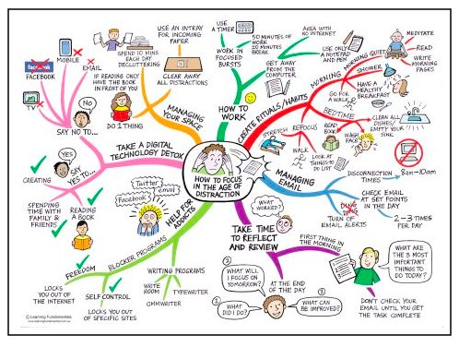
Mind Map Example

Slide 15
Mind Mapping
A Mind Map is a visual technique for helping to understand problems and solutions
Allows you to create new ideas and build connections
Helps you brainstorm and explore your problem and ideas for solving the problem
Facilitates better understanding of relationships and connections between ideas and concepts
Helps to organize ideas and concepts

Slide 16
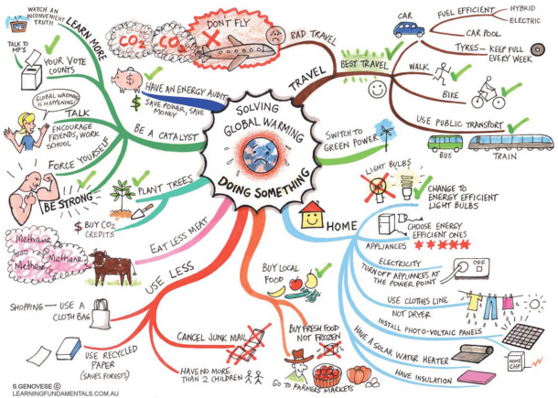

Slide 17
Making a Mind Map
Start in the CENTRE of a blank page turned sideways.
Starting in the centre gives your Brain freedom to spread out in all directions and to express itself more freely and naturally.
Put a shape in the Middle and write the problem you are trying to solve in the shape (image)
Use COLOURS throughout. Colours are exciting to your Brain as are images. Colour adds extra vibrancy and life to your Mind Map, adds energy to your Creative Thinking!
CONNECT your MAIN BRANCHES to the central image and connect your second- and third-level branches to the first and second levels, etc. Why? Because your Brain works by association. It likes to link two (or three, or four) things together.
Use IMAGES throughout. Efficient way to show ideas; keep topic labels short

Slide 18
Creating Inspiration Over Time
Keep yourself inspired, creating new ideas and revising existing ideas by creating a way to store, review and interact with your ideas.

Slide 19
Big Box or Idea Portfolio
Twyla Tharp (Dancer, Choreographer, Creative Icon)begins every project with a box
“Easily acquired. Inexpensive. Perfectly functional. Portable. Identifiable. Disposable. These are my criteria for the perfect storage system. And I’ve found the answer in the simple file box.”-Twyla Tharp, The Creative Habit
Holds newspaper clippings, visuals, notes about music, CDs
Way of organizing ideas; connecting with ideas
Provides Inspiration
Beethoven used notebooks; others use files; image boards

Slide 20
Community/Neighbourhood Description
May want to create a community description that you can use as a reference; include in your inspirational “box”
The description can take a number of forms: drawings, photos, maps, charts, video, audio or any other feature that that helps paint an accurate picture of the community
Continue over time to gather information and update your community description

Slide 21
Researching Your Problem/Idea
Helps you better understand the problem and your ideas for solving the problem
Helps you craft solutions that are well thought out and are relevant to the people affected by the problem
Credibility for your grant applications for potential funders; shows that you have a good understanding of the problem and are taking the process seriously

Slide 22
Use Existing Data and Information
Secondary Sources of Information
Information that has been collected by another organization
Advantages:
Already exists; you don’t have to collect the data
Can be easy to access (online)
Disadvantages
Not collected with your specific problem in mind
May be limitations on applicability to your situation

Slide 23
Secondary Sources of Information
Stats Canada Statistics Canada
Advantage Brantford (neighbourhood analysis) http://www.advantagebrantford.ca/OurCommunity/Neighbourhoods.aspx
Six Nations CommunityProfile
City of Brantford EmergencyShelters
Brantford Police Services (crime report, types of crimes) Monthly-stats
Homelessness http://homelesshub.ca/community-profiles/ontario/brantford
Non profit organizations: Brant Brantford Roundtable on Poverty; Brantford Food Bank; United Way

Slide 24
Look for Other Resources
Library/Librarians
Databases
Search techniques

Slide 25
What has worked elsewhere?
Do an extensive Google search to see how the problem you are tackling has been approached elsewhere
Are there any lessons to be learned?

Slide 26
Human Centred Design- Gathering Your Own Information
Those groups impacted by your idea (directly or indirectly)
Targets of your idea might include (nutrition education in schools)
Parents of children in low-income neighborhoods
The children themselves
Elementary and middle school teachers
School officials responsible for school food programs
Executives and Public Relations officers of supermarket chains
Think beyond the obvious groups to those individuals/groups who can assist or will be influencers

Slide 27
Target Groups Worksheet
Use the worksheet to identify Target Groups for your idea
Make a note of gaps in your information/information needs
As you gain experience working with the community, revisit these questions periodically and update your responses

Slide 28
Collecting Information- Human Centred Design
Observation
Engage/Interview
Watch and Listen

Slide 29
Research/Information Gathering Plan
What it is you need/want to know?
Choose the method best suited to finding that information
Determine the target group/groups from whom you need to gather the information
Develop a step by step approach for gathering the information, including a timeline
Gather the information
Record and Use the Results

Slide 30
Observation
View users and their behaviour in the context of their lives
Ensure you record your observations
Traffic- How heavy is traffic in the community? Is it mostly commercial and industrial – vans, trucks, etc. – or mostly private cars? Is there ever gridlock? Is there much bicycle traffic? Are there bike lanes? Are there bike racks in many places?
Community spaces- Are there public spaces where people can gather? Are they well kept up? Do they have seating areas, trees and plants, attractive design, cafes or food vendors, or other features to encourage people to use the space? Who uses these spaces? Is there diversity?
Community and public services. Are there identifiable community service providers and organizations in the community – mental health centers, food banks, homeless shelters, welfare offices, etc.? Are they concentrated in a particular area? Are they easy to reach by public transportation?

Slide 31
Observation
Direct or participant observation
Direct observation involves observing others
Do you want to know how people use the neighborhood park on weekends? Spend a few weekends there, watching and talking to people. Recording your observations.
If you regularly join a volleyball game or jog through the park with others, you're a “participant observer”, becoming part of the culture you want to learn about.
Record your observations; try to stay as objective as possible.

Slide 32
Observation- Tips
Think carefully about the questions you want your observation to answer
Determine where and whom to observe to answer these questions
Determine when and for how long observation should take place
Determine what you should observe and record
Record your observations
Analyze the information; draw conclusions

Slide 33
Engage/Interview
Interviewing/Guided Conversation
One of the best ways to learn more about your Target Groups/Influencers/Other important groups
Prepare some questions you’d like to ask, but expect the conversation to deviate from them
Keep the questions open-ended, not “yes/no”
“What are some examples of meals you prepare for your family?”
Elicit stories from the people you talk to- especially your target groups
Always ask “Why?” to uncover deeper meaning
Don't cut people off too quickly
Engagement/interviews can come through both short ‘intercept’ encounters and longer scheduled conversations

Slide 34
For Interviews
Get permission beforehand to record, photograph or videotape the interview (in order to capture information)
Never use any personal information in descriptions used for grant applications or disseminate that information in any way
Carefully make note of the time, place, circumstances, and details of the interview
Remember that some target users will represent the “Mainstream”, and others will represent “Exceptions”. You want to get information from both types of groups.

Slide 35
Conducting an Interview- Tips
Practice
Small-talk
Be natural
Listen
Keep your goals in mind
Don’t ask intimidating questions
Move beyond "yes/no”
Respect for your Respondents!

Slide 36
Focus Groups
Small group discussion (8-10 people) guided by a trained leader,
Used to learn more about opinions on a designated topic, and then guide future action
Can be an efficient way to collect information from a number of people at once
Disadvantages
Group dynamics/group think
Expertise to run the group

Slide 37
Characteristics of Focus Groups
They are focused on a specific topic
They have a trained facilitator
Members of the group are encouraged to talk openly about their opinions and respond to other members
Responses are recorded

Slide 38
At the Focus Group
Review the purpose of the group and goals of the meeting
Ensure participants know session is recorded- start recording
Explain how the meeting will proceed and how members can contribute
Set ground rules (let all people speak in turn)
Encourage open participation
Questions should be open-ended

Slide 39
After the Focus Group
Make a transcript or written summary of the meeting (based on recording)
Examine the data for patterns, themes and conclusions
Use the results

Slide 40
Public Forums
Can be used as a way to “observe” and collect information
Group dynamics should be noted/accounted for
Not as effective a research method as focus group, but can still provide useful information

Slide 41
Surveys
A way of collecting information that you hope represents the views of the whole group in which you are interested.

Slide 42
Surveys
Written surveys may be distributed via
mail/email
given out at community events or meetings
distributed in school
handed to people on the street
Phone or in person
with someone else writing down answers to a list of questions

Slide 43
Advantages of Surveys
Large numbers of people can give their input
Easy to list or tabulate responses (percentages)
Wide range of respondents
Disadvantages:
Often has low return rate
Requires expertise to develop
Cost

Slide 44
Deciding whether to conduct a survey
Is a survey the best way of obtaining the information you need?
The information you need may be obtained through other means, such as:
Informal unstructured conversations
Statistics Canada or other Secondary Data
Interviews with people in the community
Observation

Slide 45
Tips for Surveys
Place easier questions first
Any questions that may be threatening to the reader should appear later in the survey
Avoid words that provoke bias or emotional responses
“Are you really upset that there are no playgrounds in our community?”
Use a logical order and place similar questions together
Demographic questions should come towards the end (boring for respondent to fill in)

Slide 46
Watch and Listen
Combines observation and interview
Ask someone to show you how they complete a task
Have them physically go through the steps, and talk you through why they are doing what they do
Ask them to vocalize what’s going through their mind as they perform a task or interact with an object
Have a conversation in the context of someone’s home or workplace – many stories are embodied in artifacts.
Rapid Prototyping!

Slide 47
Rapid Prototyping
Rapid prototyping is the process of quickly mocking up your idea and validating it with target users/groups
Doing this rapidly and iteratively generates feedback early and often in the process, improving the final design
Don’t wait until your idea is “fully formed”
The goal is to use the prototyping/feedback process to develop your idea

Slide 48
Why Prototype?
To ideate and problem-solve
To communicate to target users/groups
To start a conversation
Interactions can be richer when centered around a conversation piece
A prototype is an opportunity to have a directed conversation with a user
To test possibilities
Allows you to pursue many different ideas without committing to a direction too early on

Slide 49
Storyboarding
A quick, low-resolution prototype (Models)
Storyboards can help you visualize your concept from start to finish
You don’t need to be a great artist to create a great Storyboard!
Visually plot out elements of your idea- this can help you learn a lot about your idea
Make something really rough as a way to help you think the idea through

Slide 50
Building a Storyboard
Think of your idea as a story
Break your idea into a series of steps, or discrete actions
Draw each action as a panel of the story
Use the series of comic book-style frames
Do not under any circumstances worry about your artistic ability!!!
Stick figures with cartoon bubbles to indicate dialog are perfectly adequate

Slide 51
Your Idea Title Here

Slide 52
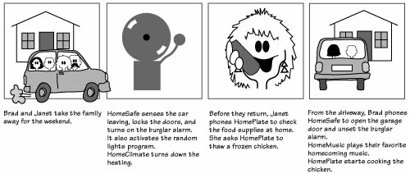
Storyboard for Home automation system

Slide 53
Take your Storyboard to Users
Take your prototype out and test it with your target groups
Put it in their hands and ask them what they make of it
Record their feedback and ideally use it to revise your storyboard

Slide 54
Ways to get Feedback on a Storyboard
Interviews, Focus Groups, Expert Interview
Ensure you capture honest feedback
Assure people that this is only a tool by which to learn and that you welcome honest, even negative feedback
Share with lots of people so that you get a variety of reactions
Make sure you’re capturing a cross-section of potential users
Write down the feedback you hear and use this opportunity to revise your ideas further

