Slide 1
PROJECT MANAGEMENT
CHANGEMAKER PROGRAM
Bronwyn Oatley @BronwynOatley

Slide 2
OBJECTIVES
Introduce project management methods, including Agile, Lean, and the Iron Triangle
Surface project planning management essentials and common pitfalls
Develop project timelines
Identify relevant project management tools
Bronwyn Oatley @BronwynOatley

Slide 3
INTRODUCTIONS
Bronwyn Oatley @BronwynOatley
Notes:
Name
What you get up to during the day
A few words on your project idea
First word that comes to your mind when you think about project management

Slide 4
INTRODUCTIONS
Your name
What you get up to during the day
A few words on your project idea
The first word that comes to your mind when you think about project management
Bronwyn Oatley @BronwynOatley

Slide 5
PROJECT MANAGEMENT
Bronwyn Oatley @BronwynOatley

Slide 6
WHY DO WE PLAN?
@BronwynOatley

Slide 7
Why Plan?
Establish a common vision for a project
Identify common, and dissimilar objectives amongst teammates
Identify our assumptions, biases amongst teammates
Establish what success would look like
Identify timelines, deliverables etc.
Set team ground rules
Time/ location of meetings
Roles
Amount of work
Hierarchy
Determine scope, budget and quality of project
Others?
Bronwyn Oatley @BronwynOatley

Slide 8
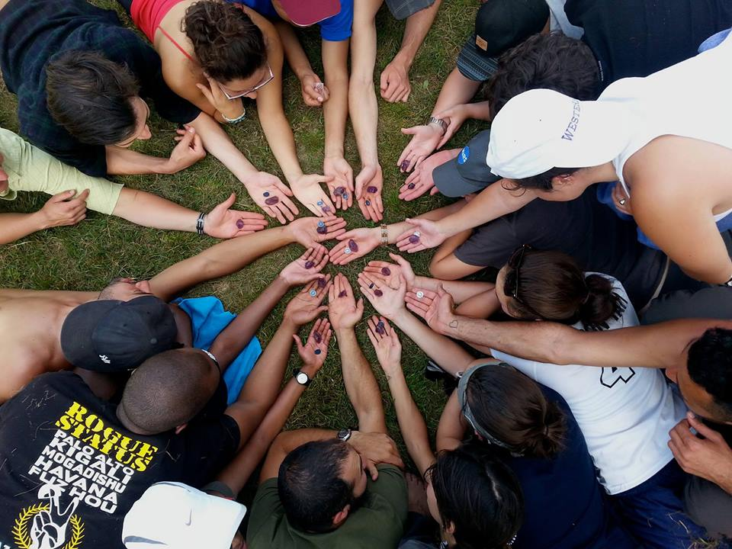
WHAT SHOULD BE IN A PLAN?
@BronwynOatley

Slide 9
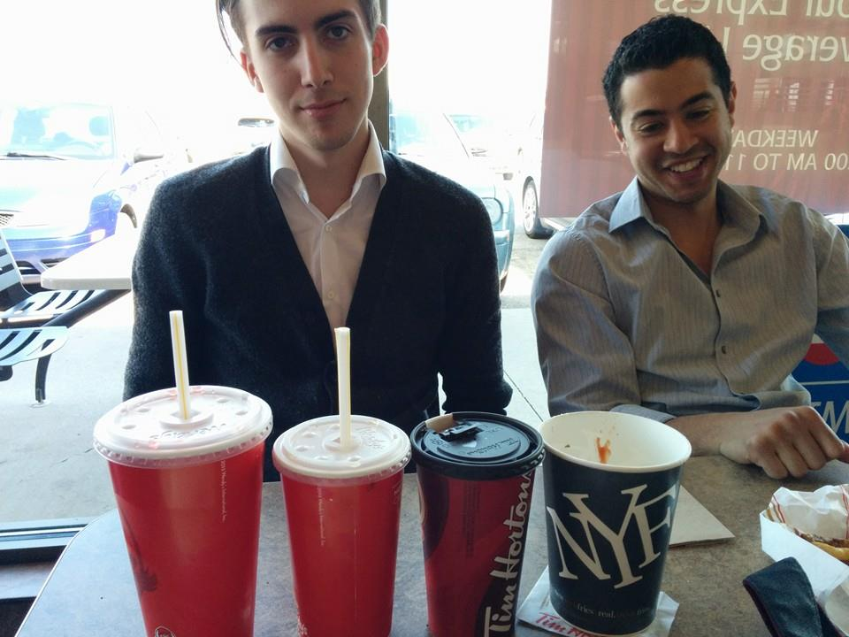
WHAT SHOULD BE IN A PLAN?
@BronwynOatley

Slide 10
What should be in a plan?
Exactly what’s needed to achieve your outcomes, which might include consideration of some of the following things:
Project objectives and key deliverables
Key project activities
Timeline
Budget
Scope
Team, roles, values, approach to work
It might also include sub-plans focused on:
Fundraising
Communications
Project ideation, design, implementation, evaluation
Community engagement/ participation
Others?
Bronwyn Oatley @BronwynOatley

Slide 11
YOUR APPROACH
@BronwynOatley

Slide 12
Pair Discussion: What is your approach to project management?
Describe a project you’ve helped to plan or manage.
What parts of it you actively ‘manage’? What did you do out of necessity?
What worked best? What worked least well?
What are some of your personal strengths when it comes to project management? What are some areas for improvement?
Bronwyn Oatley @BronwynOatley

Slide 13
Group Discussion: Project Management Musts
What are some of the most useful project management tools/ approaches we use?
What are some of the approaches/ things that most often hold us back?
Bronwyn Oatley @BronwynOatley

Slide 14
BUDGET
QUALITY
SCOPE
SCHEDULE
IRON TRIANGLE
@BronwynOatley

Slide 15
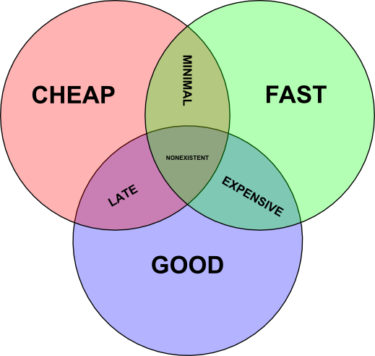

Slide 16
Iron Triangle Take-Aways
It can be helpful to determine / ask about scope, budget and schedule.
It can be useful to consider that it can be tough to have it all (inexpensive, quick, and high-quality)
It can be useful as a team to prioritize among the three
MOST USEFUL IF: Your project deliverables, timeline, and budget are clear
Bronwyn Oatley @BronwynOatley

Slide 17
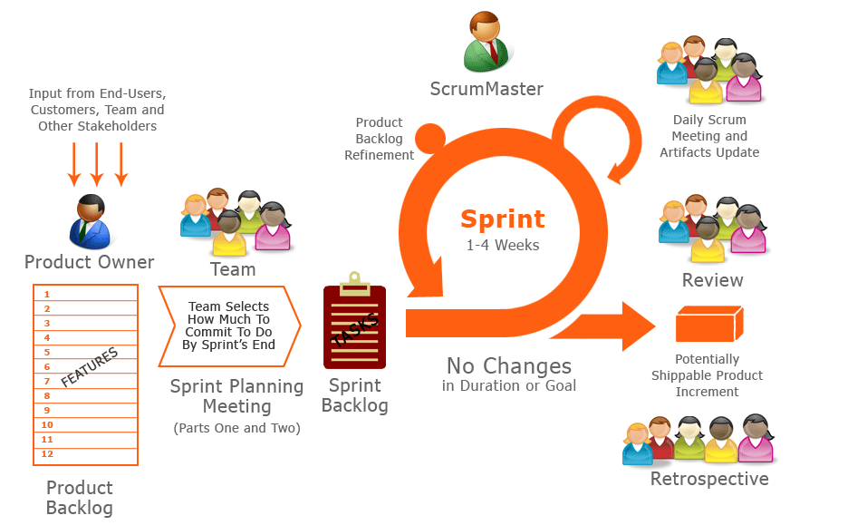
AGILE

Slide 18
AGILE Take-Aways
Consider working in ‘sprints’, building your list of upcoming tasks based on what most needs to be done before evaluating your work
Consider team roles and and assigning a ‘Product Owner’ and ‘Scrum Master’ role
Might it work for your team to try and keep meetings brief, only reviewing what is most pertinent to the day ahead?
MOST USEFUL IF: Your building a project that faces tight timelines, and is quite complex (and could be taken in lots of different directions)
Bronwyn Oatley @BronwynOatley

Slide 19
LEAN STARTUP
@BronwynOatley

Slide 21
Lean Startup Take-Aways
Entrepreneurship is about testing hypotheses
What separates great entrepreneurs from bad ones is that great ones know when to pivot (and how to pivot)
Good entrepreneurship is about creating something that people actually want/ that the user actually needs
What should be in your MVP? Only what you need to advance your learning / test your hypothesis about what your user needs.
Start with your riskiest assumption
MOST USEFUL IF: How you ‘solve’ your problem is unknown AND you’re working with a team that’s comfortable with moving and adapting quickly
Bronwyn Oatley @BronwynOatley

Slide 22
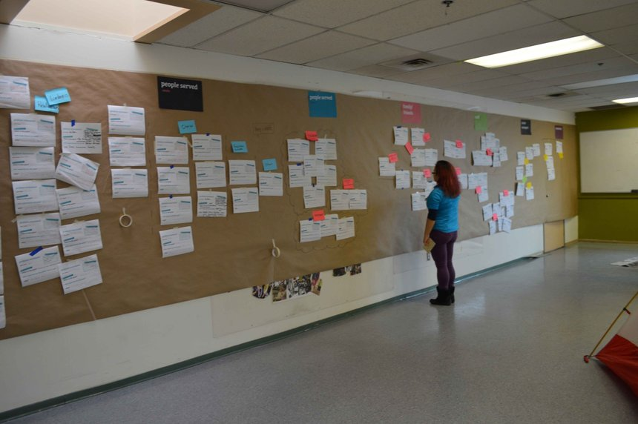
DESIGN THINKING
@BronwynOatley

Slide 23
PAIR DISCUSSION
WHICH APPROACH MIGHT BE MOST USEFUL FOR YOU?
Bronwyn Oatley @BronwynOatley

Slide 24
BREAK
15 MINUTES
Bronwyn Oatley @BronwynOatley

Slide 25
BREAK
15 MINUTES
Bronwyn Oatley @BronwynOatley

Slide 26
ACTIVITY PROJECT TIMELINES
Bronwyn Oatley @BronwynOatley

Slide 27
DESIGN SPRINTS
Discovery
Sketch competing solutions
Choosing a Hypothesis to test
Create a prototype
Test it with humans
Bronwyn Oatley @BronwynOatley

Slide 28
Prompts:
Plot our your project’s timeline, building on the calendar provided or using a preferred calendar tool.
Consider including:
Key project deliverables (f known, if possible to estimate)
Additional relevant dates, including: team meetings, stakeholder meetings, Changemaker Workshops, related dates that might influence your work.
Consider including ‘project phases’, ex. “Discovery, Design, Delivery, Evaluation”
Upcoming tasks to be completed (consider using the Agile approach of developing spring or product backlogs)
If relevant, generate a list of questions you need answers in order to complete your project timeline.
Bronwyn Oatley @BronwynOatley

Slide 29
PAIR & SHARE:
What’s best about your partner’s timeline?
What could be improved?
Bronwyn Oatley @BronwynOatley

Slide 30
GROUP DISCUSSION
What needs to be included in our plans?
Bronwyn Oatley @BronwynOatley

Slide 31
USEFUL TOOLS
Project Management Tools: Smartsheet, Asana, Basecamp
Calendar Tools: Google Calendar, Outlook
Meeting Organization Tools: Doodle
Virtual Meeting Tools: Skype, Google Hangout
Digital Storage Tools: Google Drive, Dropbox
Bronwyn Oatley @BronwynOatley

Slide 32
CONCLUSION
Bronwyn Oatley @BronwynOatley

